Slide 1
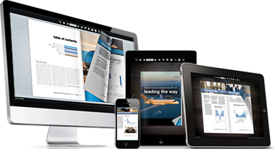
eBooks, eAudio & eMagazines
Access online resources PC/tablet

Slide 2
What’s all this eStuff?
Electronic distribution of multimedia, audio and written word.
Available for download online, files can be read on your computer or smart device.
eBook: a book-length publication in digital form, consisting of text and images.
eMagazine: online versions of magazines
eAudio: Spoken word, narrated books, podcasts, music.

Slide 3
Where to get Free eBooks?
Local Libraries
Google eBookstore
iTunes - iBooks
Project Gutenburg
Internet Archive
BookBoon (technical)
ManyBooks.net
Free eBooks.net
LibriVox (audio)
Issuu

Slide 4
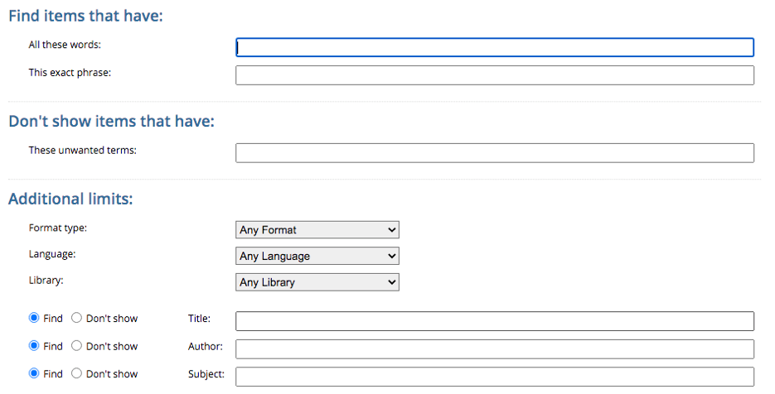
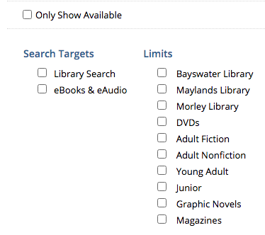
City of Bayswater Libraries https://www.bayswater.wa.gov.au/arts-and-leisure/libraries/e-library-and-catalogue (google: city of bayswater library)
Online Catalogue (Paper books)
Browse catalogue, login to check/renew loans/history
Advanced Search
Notes:
CL112B1234528D

Slide 5
City of Bayswater Libraries http://www.bayswater.wa.gov.au (google: city of bayswater library)
OverDrive* and Libby (eBooks)
http://help.overdrive.com
Can be used on your PC or smart devices
Android
Chromebook
Apple devices
Windows
Kindle
Kobo tablets
NOOK tablets
Borrow Box (eAudio)
OverDrive* and Libby (eMagazines)
formerly Rbdigital/Zinio
Kanopy (video)
*Use landscape on tablets

Slide 6
Overdrive ...on the PC
Books can be read in the Browser on your computer or via an app on many smart devices.
You must have a valid Library Card which has been given access to the service.
The service must be assigned to a library – in this case City of Bayswater.
Use the Launch Page from Bayswater Web Site.
There are 2 bookshelves (Library & Personal) in the App

Slide 7
Overdrive Portability
Overdrive Account allow you to share books across multiple devices
Libby and Overdrive both work on mobile devices
Overdrive remembers bookmarks, settings and pages
Adobe Digital Editions, Calibre, Stanza and other epub readers allow you to view downloaded books on your computer
Note: This can cause problems with authorisation on mobile devices

Slide 8
Overdrive vs Libby
Libby is the newer App.
Libby is compatible with Android and IOS devices and can be used in browsers on computers and tablets
Overdrive works on more devices including Kindle and Windows mobile.
Overdrive supports transfer to other e-readers and MP3 players
There are 2 bookshelves (Library & Personal) in the App

Slide 9
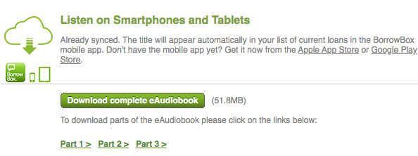
Borrow Box
Audio Books can be downloaded to your PC and played, or via an app on many smart devices.
You must have a valid Library Card which has been given access to the service. (case sensitive)
The service is automatically assigned to your library.
Use the Launch Page from City of Bayswater Web Site.
*Show available only works in search

Slide 10
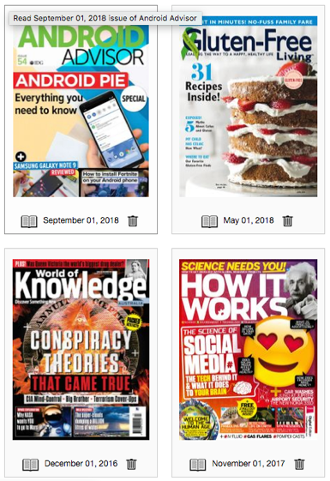
Rbdigital ...on the PC
Magazines can be read in the Browser on your computer or via an app on many smart devices.
You must create a RBdigital account to read magazines. (Zinio accounts will also work)
The service is free when accessed via your library City of Bayswater.
Magazines can also be purchased directly.
Use the Launch Page from Bayswater Web Site.

Slide 11
Magazines ...PC and Devices
Magazines can be read in the Browser (overdrive.com,libbyapp.com) on your computer or via an app (Libby, Overdrive) on many smart devices.
You can use Overdrive or Libby with your library account to read magazines.
The service is free when accessed via your library City of Bayswater.
Use the Launch Page from Bayswater Web Site.
User filter + Media Type for Magazines
Click search magnifying glass then media type

Slide 12
Apps – Let’s test them out!
There are many App versions of eReaders available including: Overdrive, Libby, Borrow Box
iOS – iPad, iPhone
Android
Windows
https://help.libbyapp.com/6103.htm
*Kanopy – New The Great Courses

Slide 13
Lets Explore some other sites...
Google eBookstore
iTunes - iBooks
Project Gutenburg
Internet Archive
BookBoon (technical)
ManyBooks.net
Free eBooks.net
LibriVox (audio)
Issuu
LibriVox (audio)
OK Google, talk to Book Reader (speakhub)
Hey Google ask Book Reader to play Dracula Guest

Slide 14
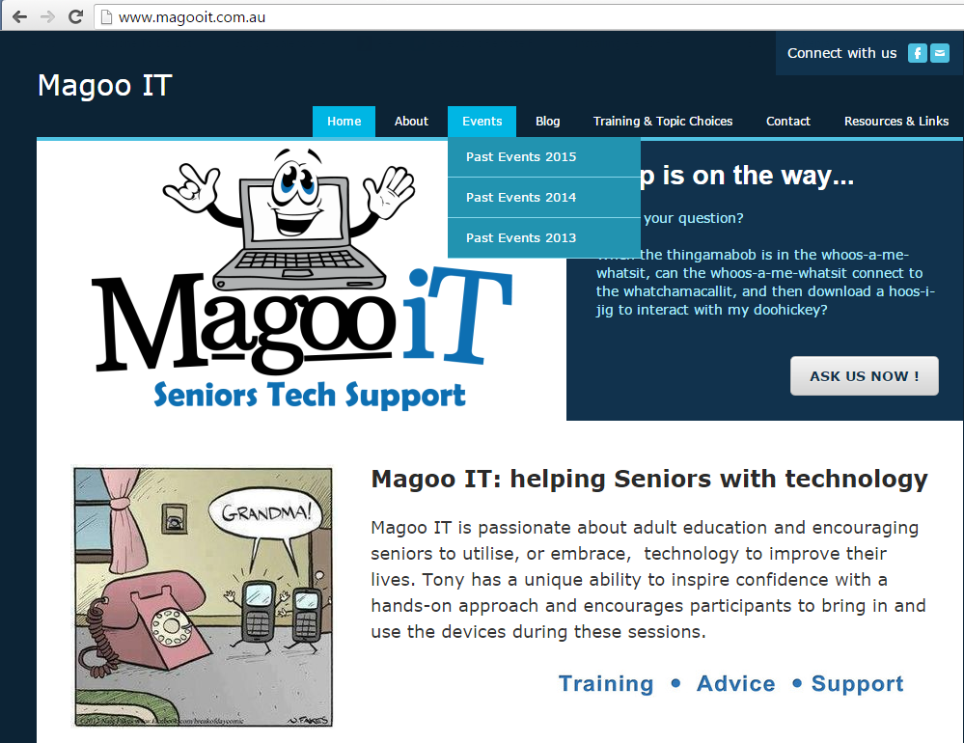
Thank you!
support@magooit.com.au
www.magooit.com.au

